Slide 1

Being, Non-Being, and Forms of Being
Course: Philosophy
Prepared by: Ospan Ramazan
Instructor: Sabitov Almas Gazizovich

Slide 2
Introduction
This presentation explores the philosophical concept of Being and Non-Being. It is one of the central themes in ontology, addressing questions of existence and reality.

Slide 3

Definition of Being
Being is a fundamental philosophical concept that describes existence and reality. It is often contrasted with Non-Being, forming key philosophical oppositions such as:
- Being vs. Consciousness
- Being vs. Thinking
- Being vs. Essence

Slide 4

What It Means to Be Human
Philosophy helps us explore deep questions about life:
- Birth, death, and existence
- Free will and personal identity
- Love, regret, and human agency
Different philosophical traditions approach Being in unique ways.

Slide 5
Being in Kazakh Thought
The Kazakh understanding of Being includes:
- The nomadic way of life
- Patience, perseverance, and adaptability
- Freedom, peace, and reconciliation
- Learning from history while moving toward a positive future.

Slide 6
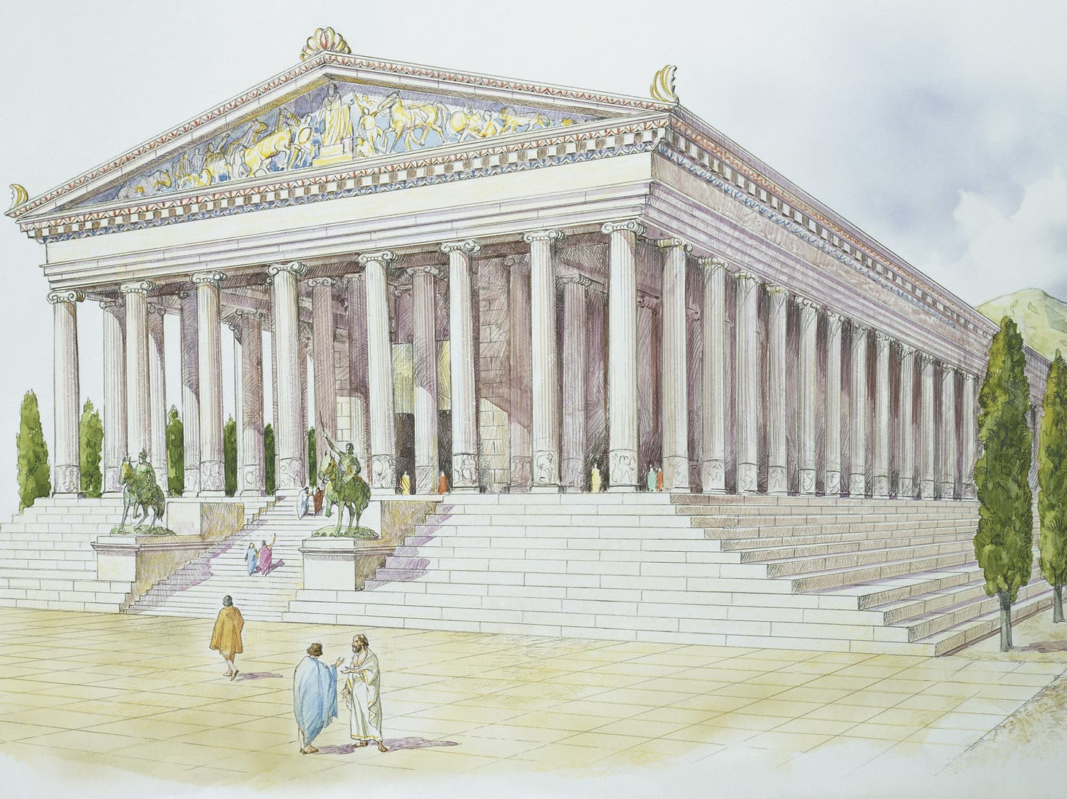
Being in Ancient Philosophy
The concept of Being appeared in Ancient Greece, especially in the Eleatic school:
- Parmenides: Being is eternal and unchangeable.
- Heraclitus: The Logos is the principle of reality.
- Pythagoras: Numbers form the foundation of the universe.

Slide 7
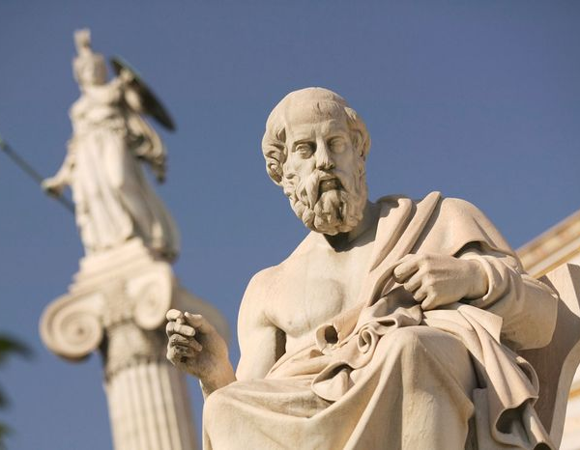
Plato and Being
- Plato saw Being as a world of ideas (forms).
- The physical world is only a reflection of the true, eternal forms.
- Truth and knowledge come from understanding these higher forms.

Slide 8
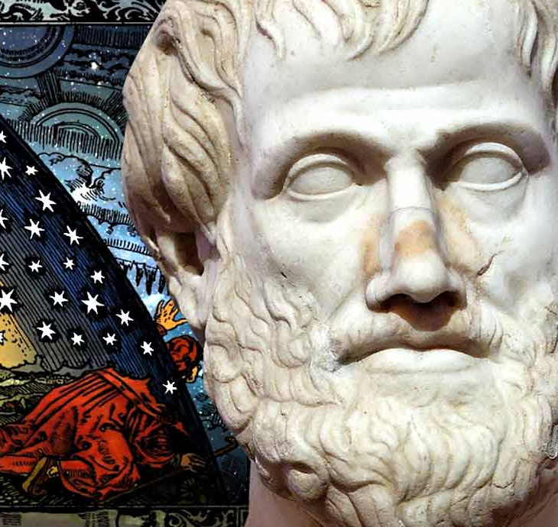
Aristotle's Understanding of Being
- Aristotle rejected the idea of Being as the highest concept.
- He identified Being with substance and essence.
- He analyzed the different meanings of 'to be'.

Slide 9
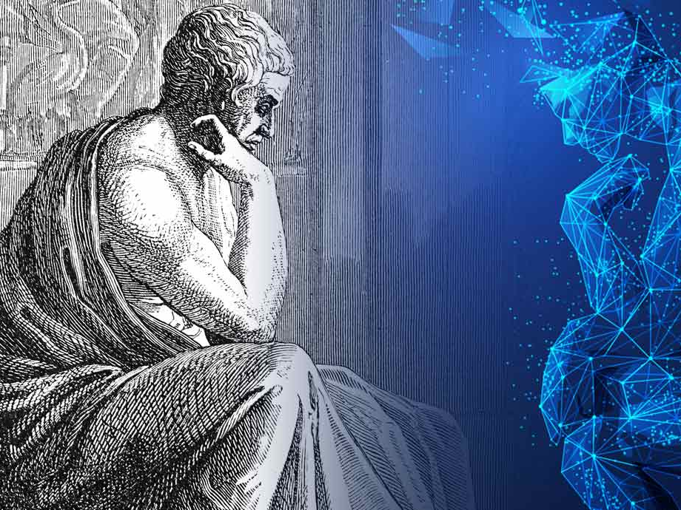
Being in Medieval and Modern Thought
- Medieval philosophy was influenced by religious views of Being.
- The dispute between Realists and Nominalists reflected different perspectives on existence.
- In the 19th century, philosophers like Nietzsche and Kierkegaard criticized traditional ontological views.

Slide 10
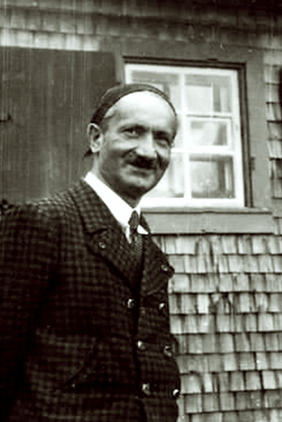
Heidegger's View on Being
- Martin Heidegger saw Being as an existential event.
- He introduced the term Dasein (Being-in-the-world), emphasizing human existence.
- Being is not a theoretical concept but a lived experience.

Slide 11

- Being is a central concept in philosophy, from Ancient Greece to modern times.
- It is connected with existence, essence, truth, and human values.
- Different traditions provide unique insights into the nature of Being.

Slide 12
References
1. Lecture Notes on Philosophy
2. Works of Plato and Aristotle
3. Heidegger’s Existential Philosophy
4. Studies on Kazakh Cultural Perspectives on Being

